Slide 1
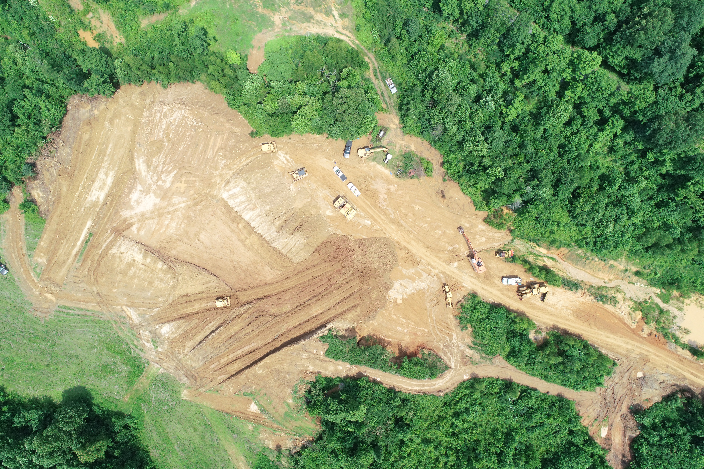
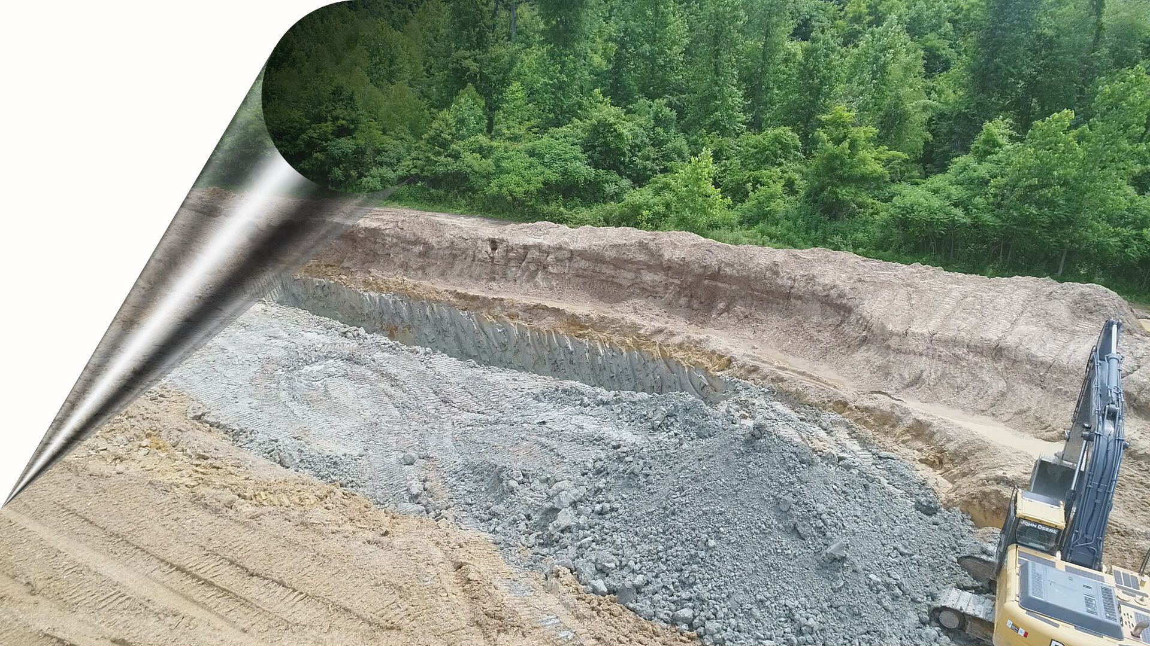
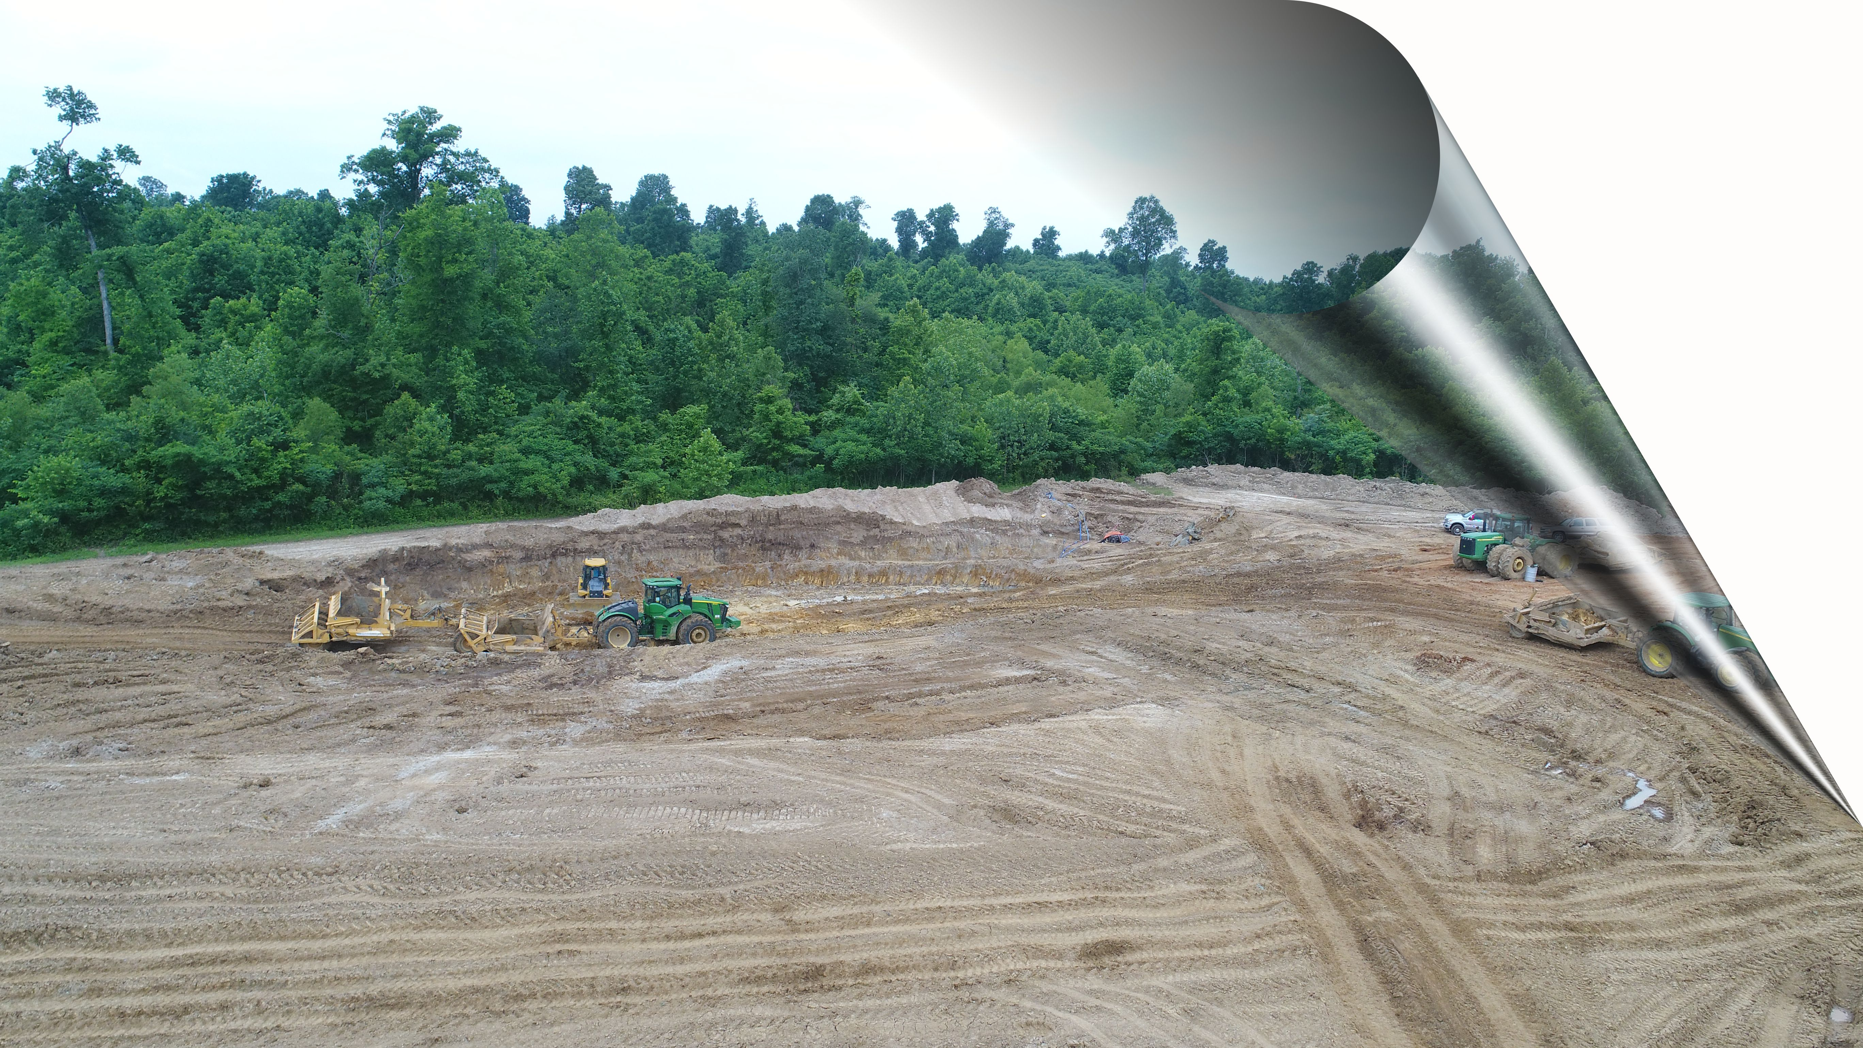
BUSINESS OPPORTUNITY
--------------
BALLARD CONSERVATION, LLC
JUNE 15, 2022

Slide 2
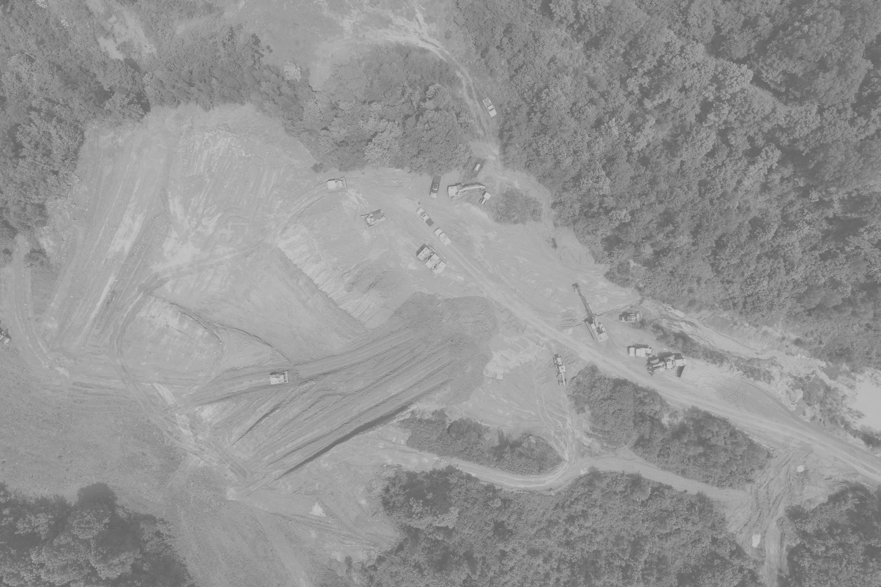
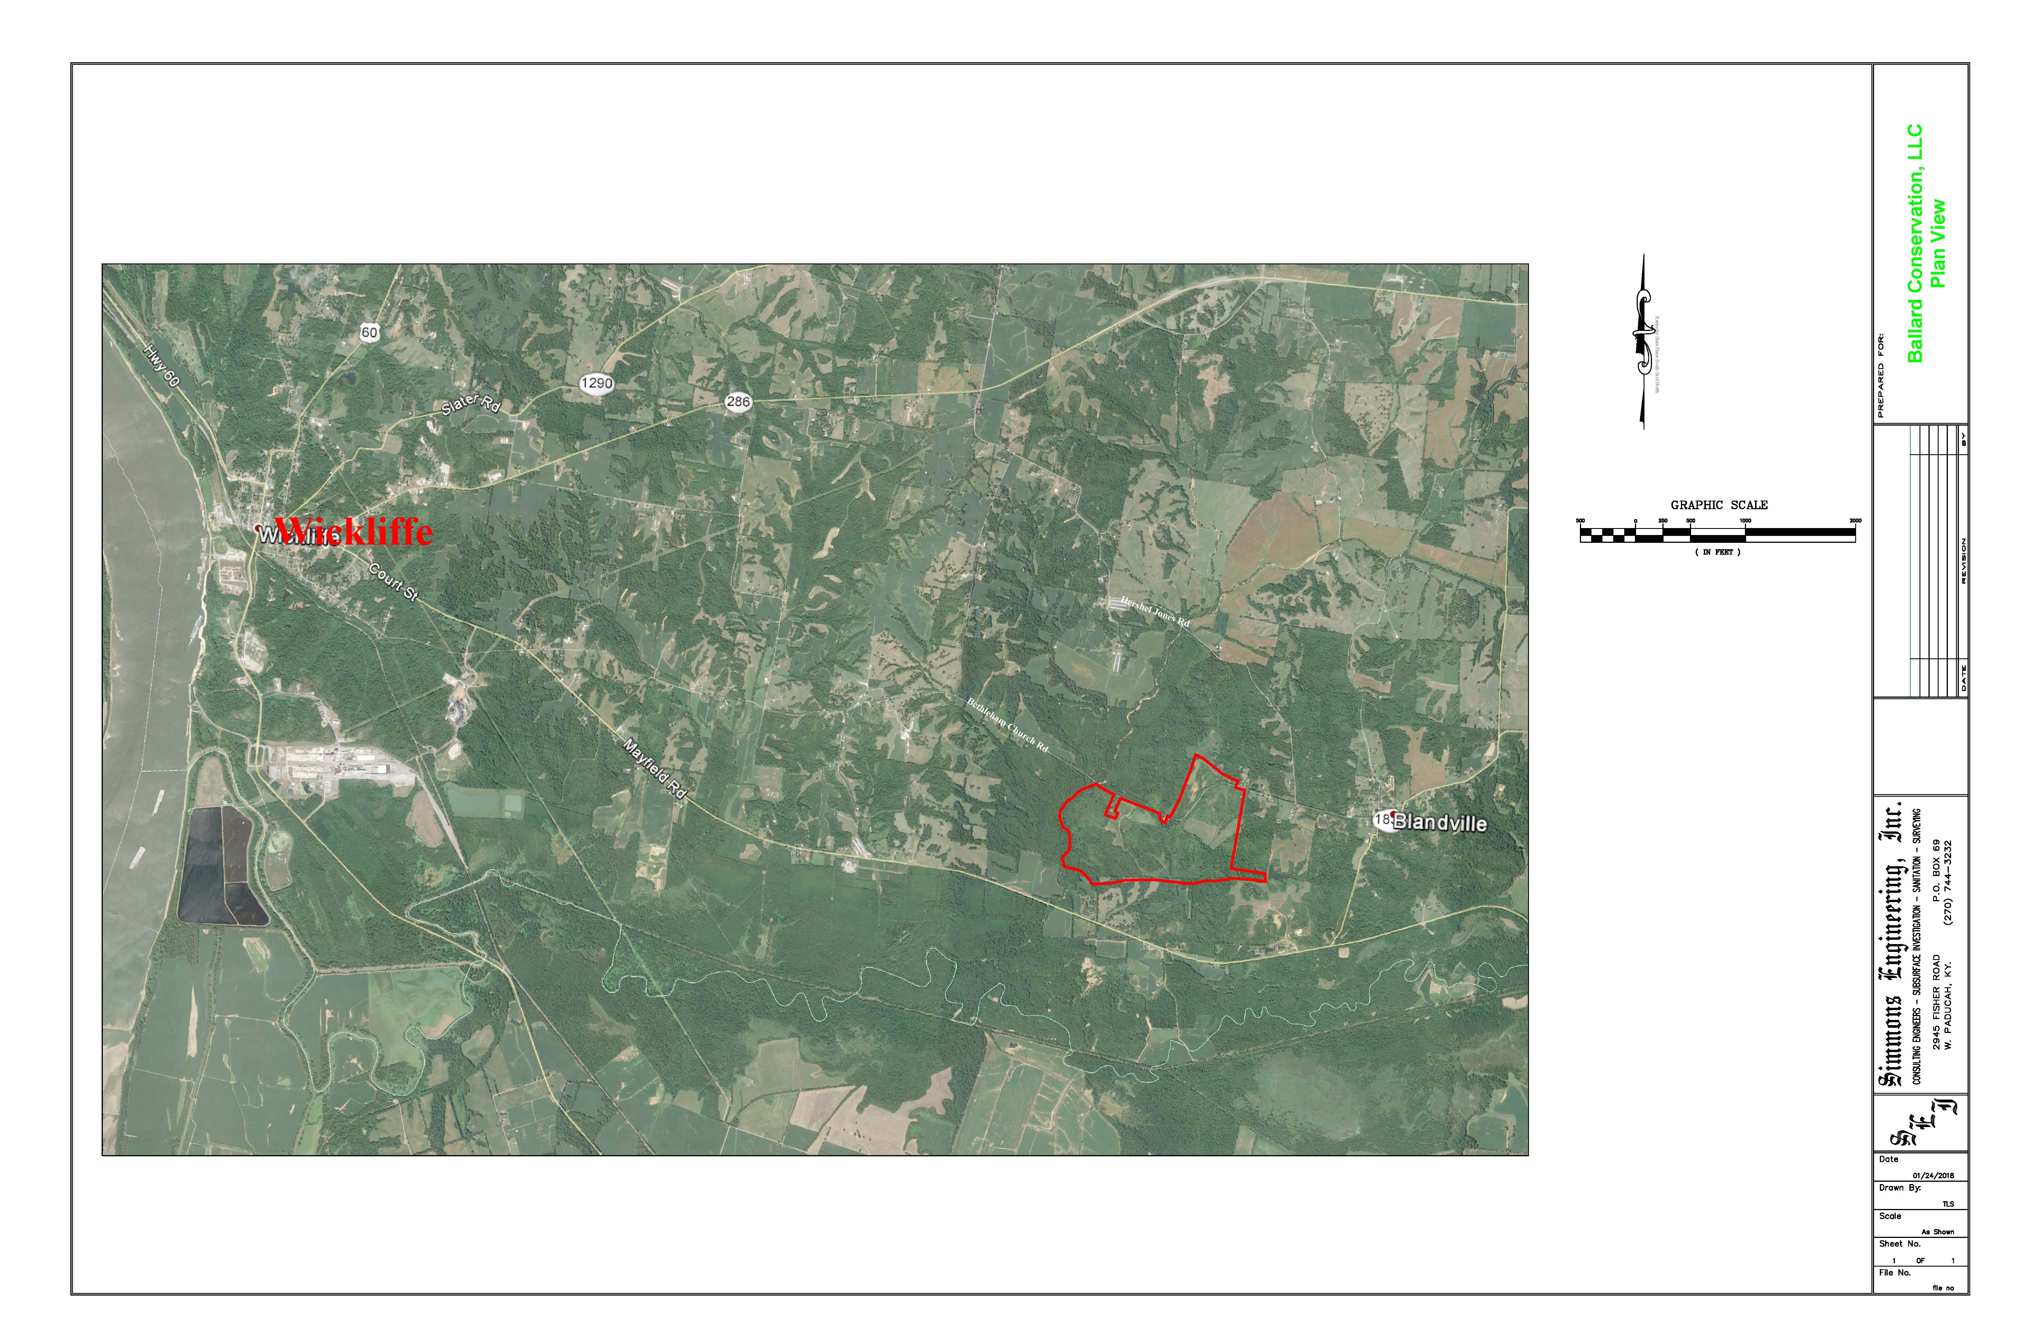
Ballard Conservation, LLC (BC) is a privately held, start-up company, located in far Western Kentucky near the confluence of the Mississippi and Ohio rivers.
Approximatly 6 Miles
Ballard Conservation, LLC

Slide 3
Ballard Conservation, LLC (BC) possesses large reserves of sand, rock and ball clay. These reserves have been proven with detailed geological studies and professionally authored reports. BC has operating, fully permitted mine sites for immediate mining of its minerals. Due to the close proximity to two interstate exchanges, Canadian National main rail line and the Ohio and Mississippi Rivers, BC is capable of transporting minerals via truck, rail, or barge.

Slide 4
BC will make a significant impact on the transportation and construction industries in Kentucky, the mid-west region, and nationally. BC is seeking investors to fully commercialize its mineral assets into high-value consumable products for domestic and international sales.

Slide 5
TRANSPORTATION AGGREGRATE AND SAND
Two key components of Road infrastructure are cost and safety. The use of polished resistance aggregate as a surface treatment, for both asphalt and concrete construction, has proven significant safety performance over conventional limestone aggregate. Working with the Kentucky Transportation Cabinet Materials Division, BC has determined its significant rock reserves can be processed into superior quality Polished Resistant Coarse and Fine aggregate. Concrete and asphalt road construction with longer durability and superior traction result in greater highway safety.
Material Testing 1-19-18
The Kentucky Transportation Cabinet Materials Testing Division is responsible to determining the types and quality of material to be utilized in state projects. Working with BC they have performed sampling and testing of BC sand and gravel deposits at the quarry in Ballard County, Kentucky.

Slide 6
Summarizing the KTC lengthy process for Certification, KTC certifies sources and publishes the available source material producers for use in Kentucky projects. For course aggregate, fine aggregate, and sand this takes about 2 months and involves facility requirements (i.e. lab, scales and crusher), personnel (certified aggregate technician) and material quality verification.
Material Quality has three major properties for aggregates and three properties for sand.
Material Quality has three major properties for aggregates and three properties for sand.
STANDARDS and TEST results for Polish Resistant Aggregate (course)
Standard Test Results
Insoluble residue >50% (ASTM D 3402-KM265) 96%
Soundness <9.0% (T 104) 1.3%*
Crushed faces >2 Crushed Material > 2 faces
STANDARDS for POLISHED RESISTENT SAND
Standard Test Results
Insoluble Residue >50% 96%
Soundness<9.0% 1.3%
Concrete Sand Equivalency >80% (KM 64-605) 94% white sand
Asphalt Sand Equivalency >45% (AASHTO T 176) 64%

Slide 7
Soundness not yet performed on gravel just sand, but KTC believes numbers will be similar. Actual KTC test sheets available.
Ballard Conservation, LLC - CONFIDENTIAL INFORMATION
-------END of KTC Report------
The comparable mix cost for highway construction utilizing BC aggregate will be a wise choice to reduce taxpayer costs, resulting in safer miles for each dollar expensed in road construction. The combination of cheaper mining costs, along with reduced transportation utilizing barge conveyance, on the river corridors of the Ohio, Mississippi, and their tributaries or rail on the local main lines, will provide a real cost advantage over other sources of supply such as Foreign Calcium Bauxite imports.
BC sand, which has been tested by KTC and others, will work in both asphalt and concrete formulations. This natural sand is superior to limestone manufactured sand in most road or construction projects.

Slide 8
LANDSCAPE AND DECTORATIVE ROCK, STONE & SAND
BC reserves are formations of Pleistocene alluvial gravel containing a mixture of gravel, sand and clay. Upon washing and sizing the gravel, significant quantities of landscape and decorative stone are produced, which, when packaged have higher commercial retail value.($200/ton) See samples.

Slide 9
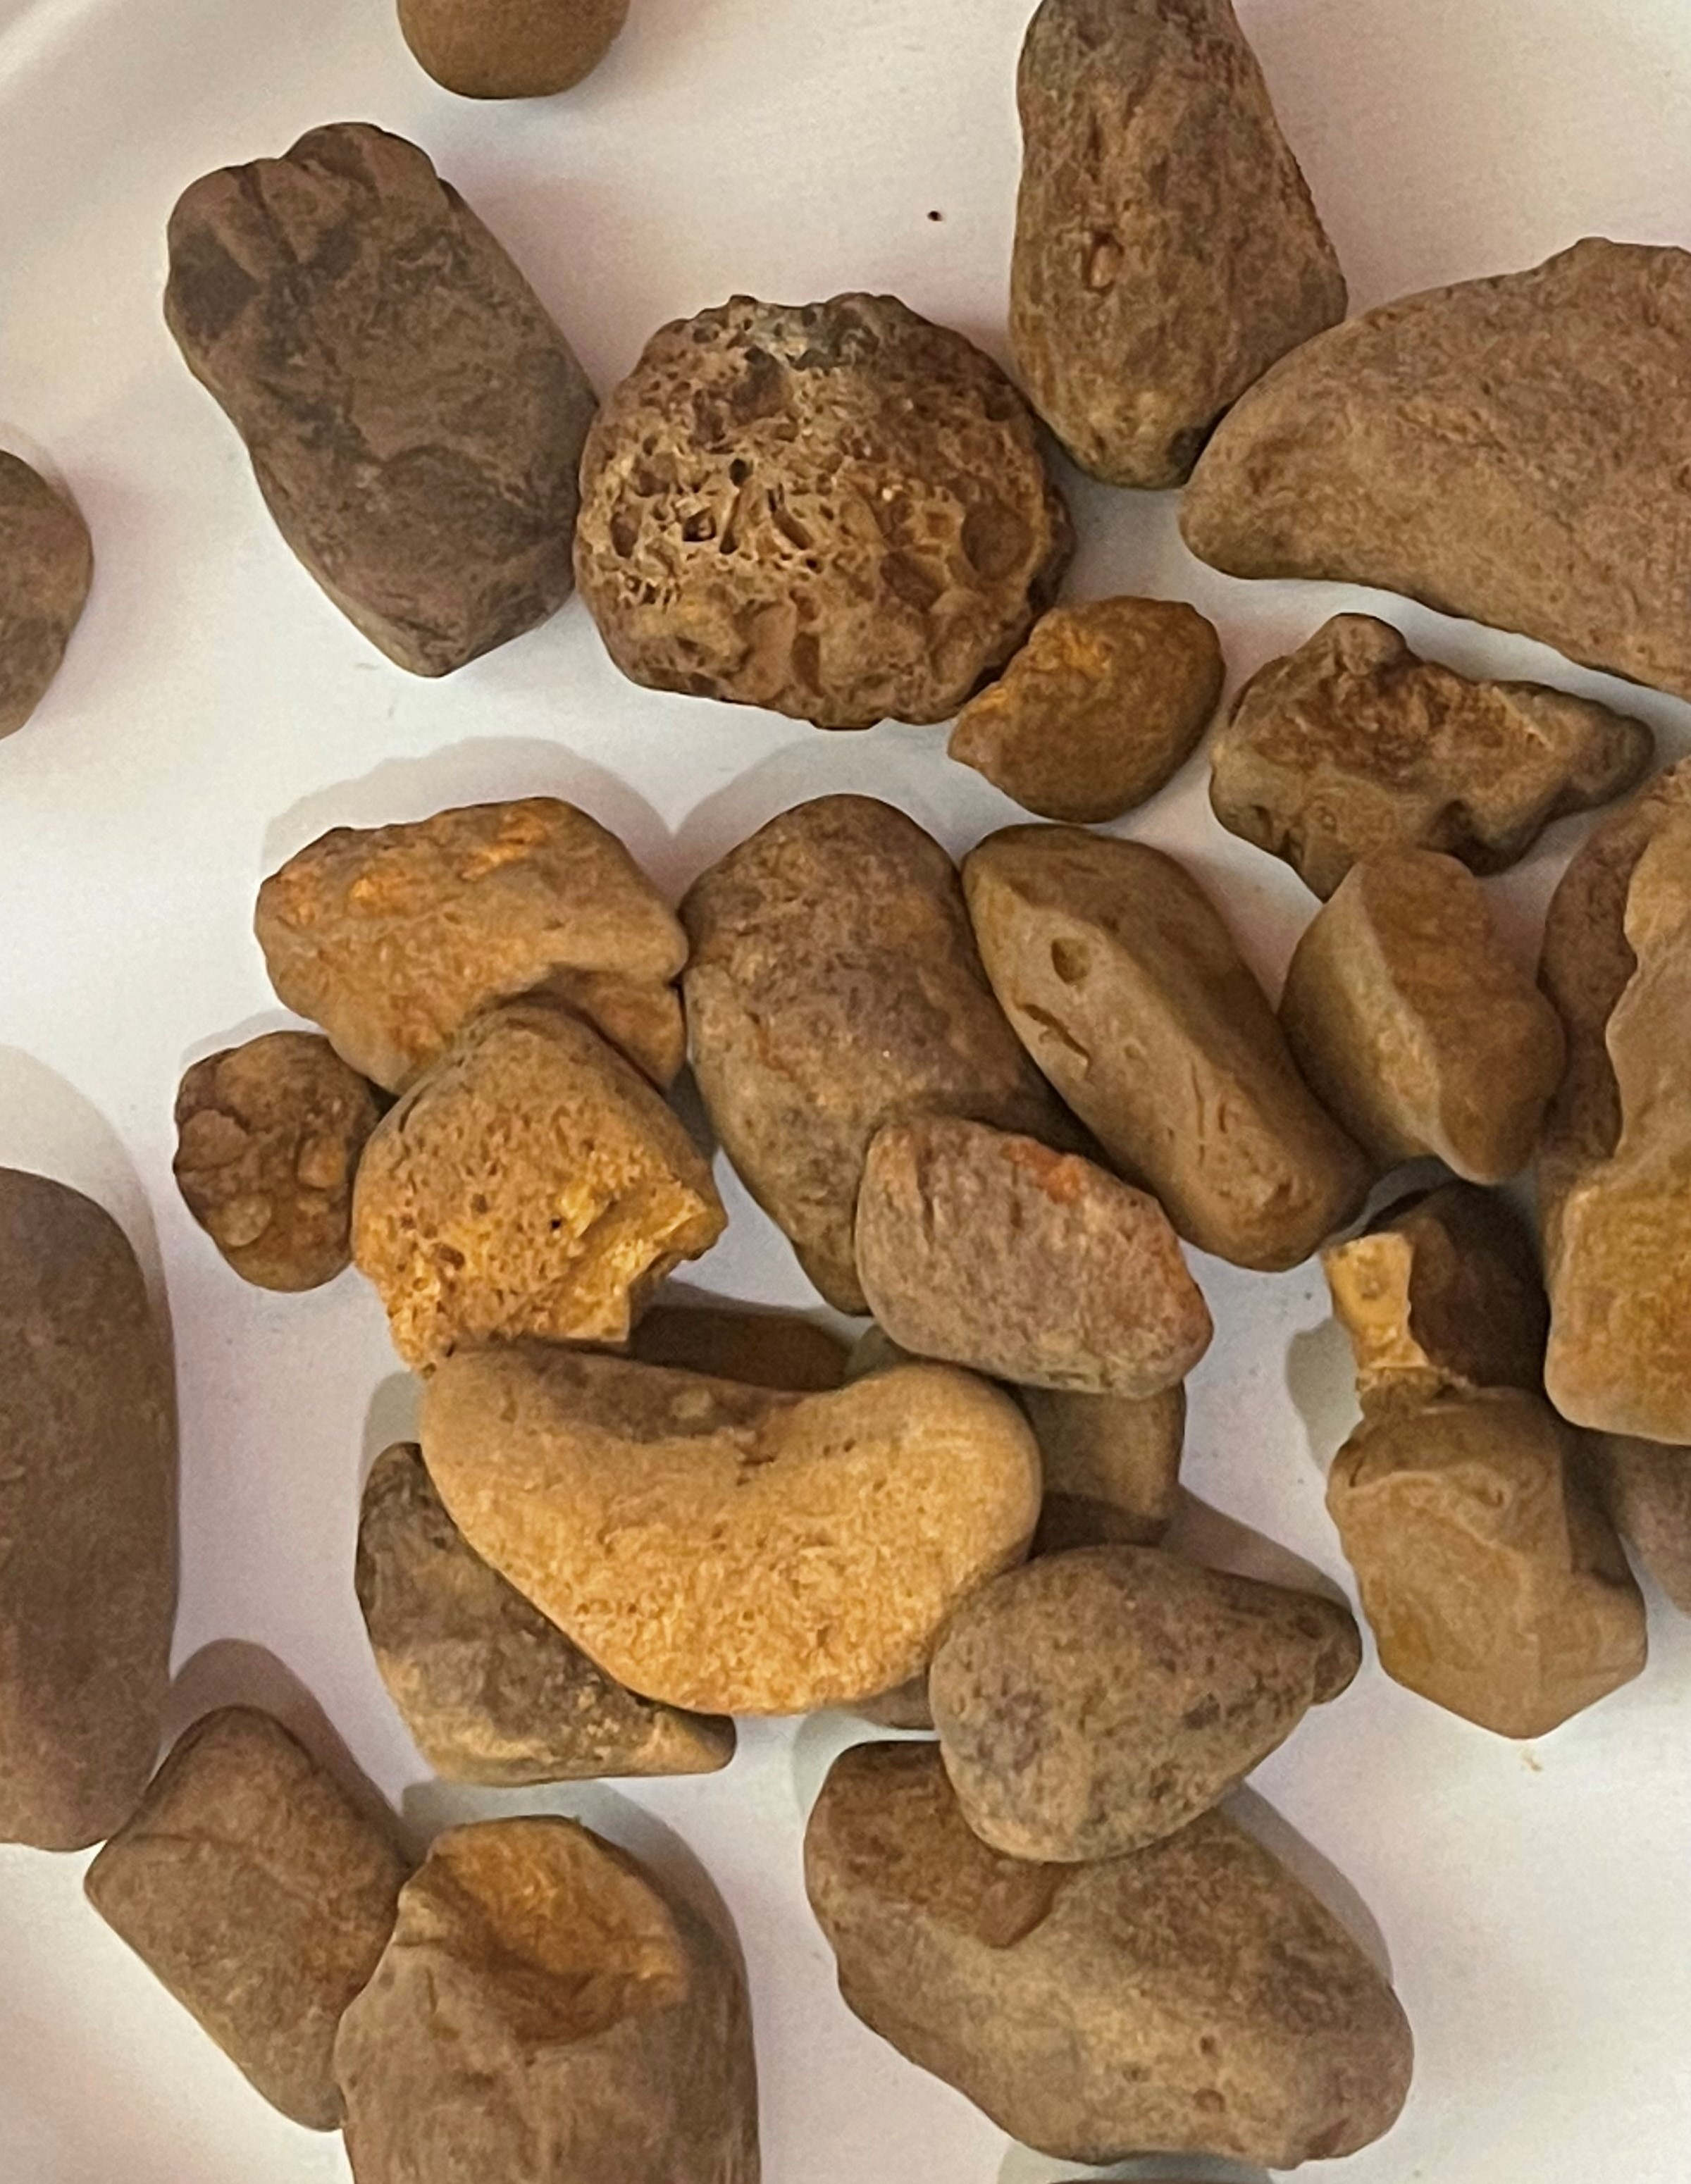
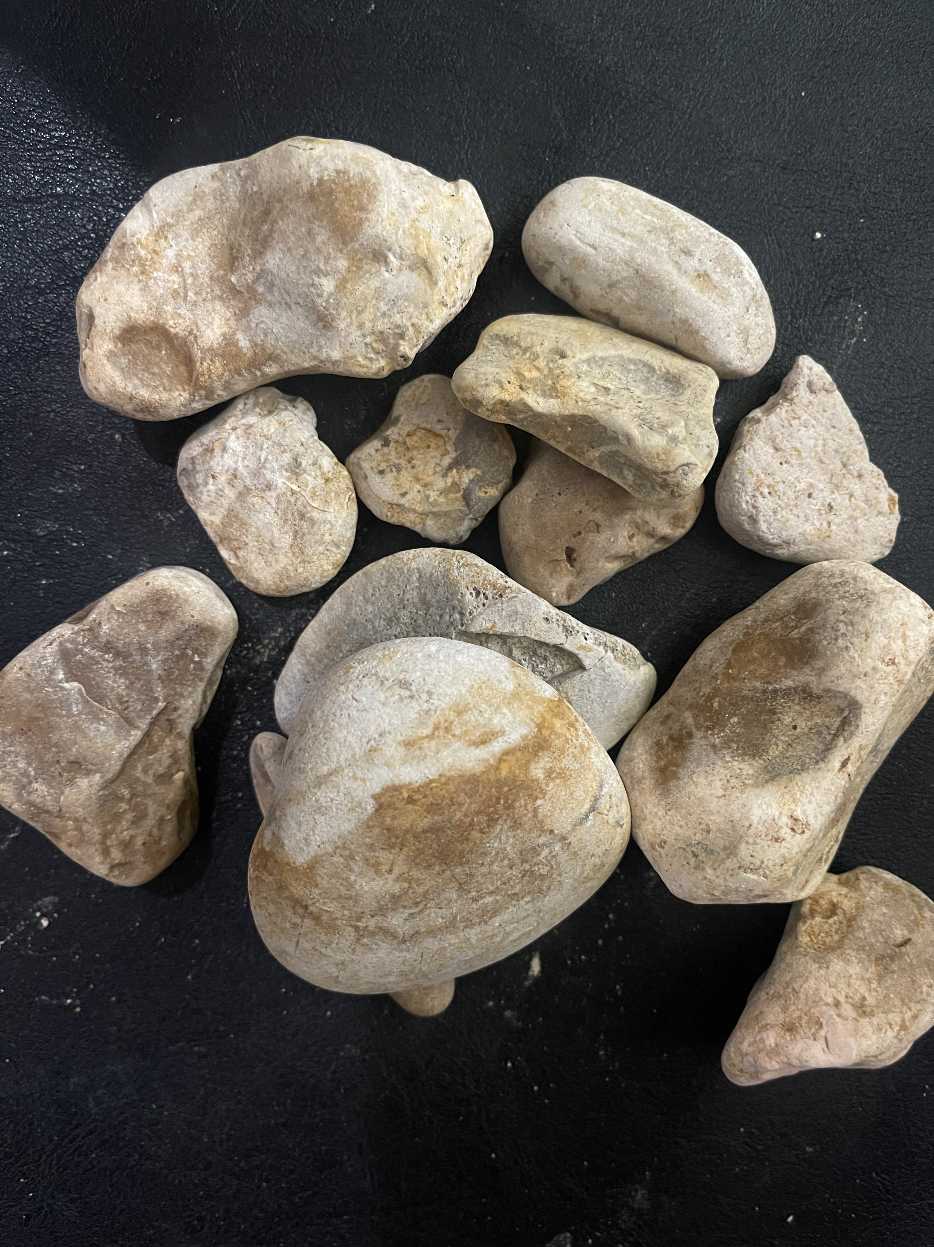
LANDSCAPE AND DECTORATIVE ROCK, STONE & SAND

Slide 10
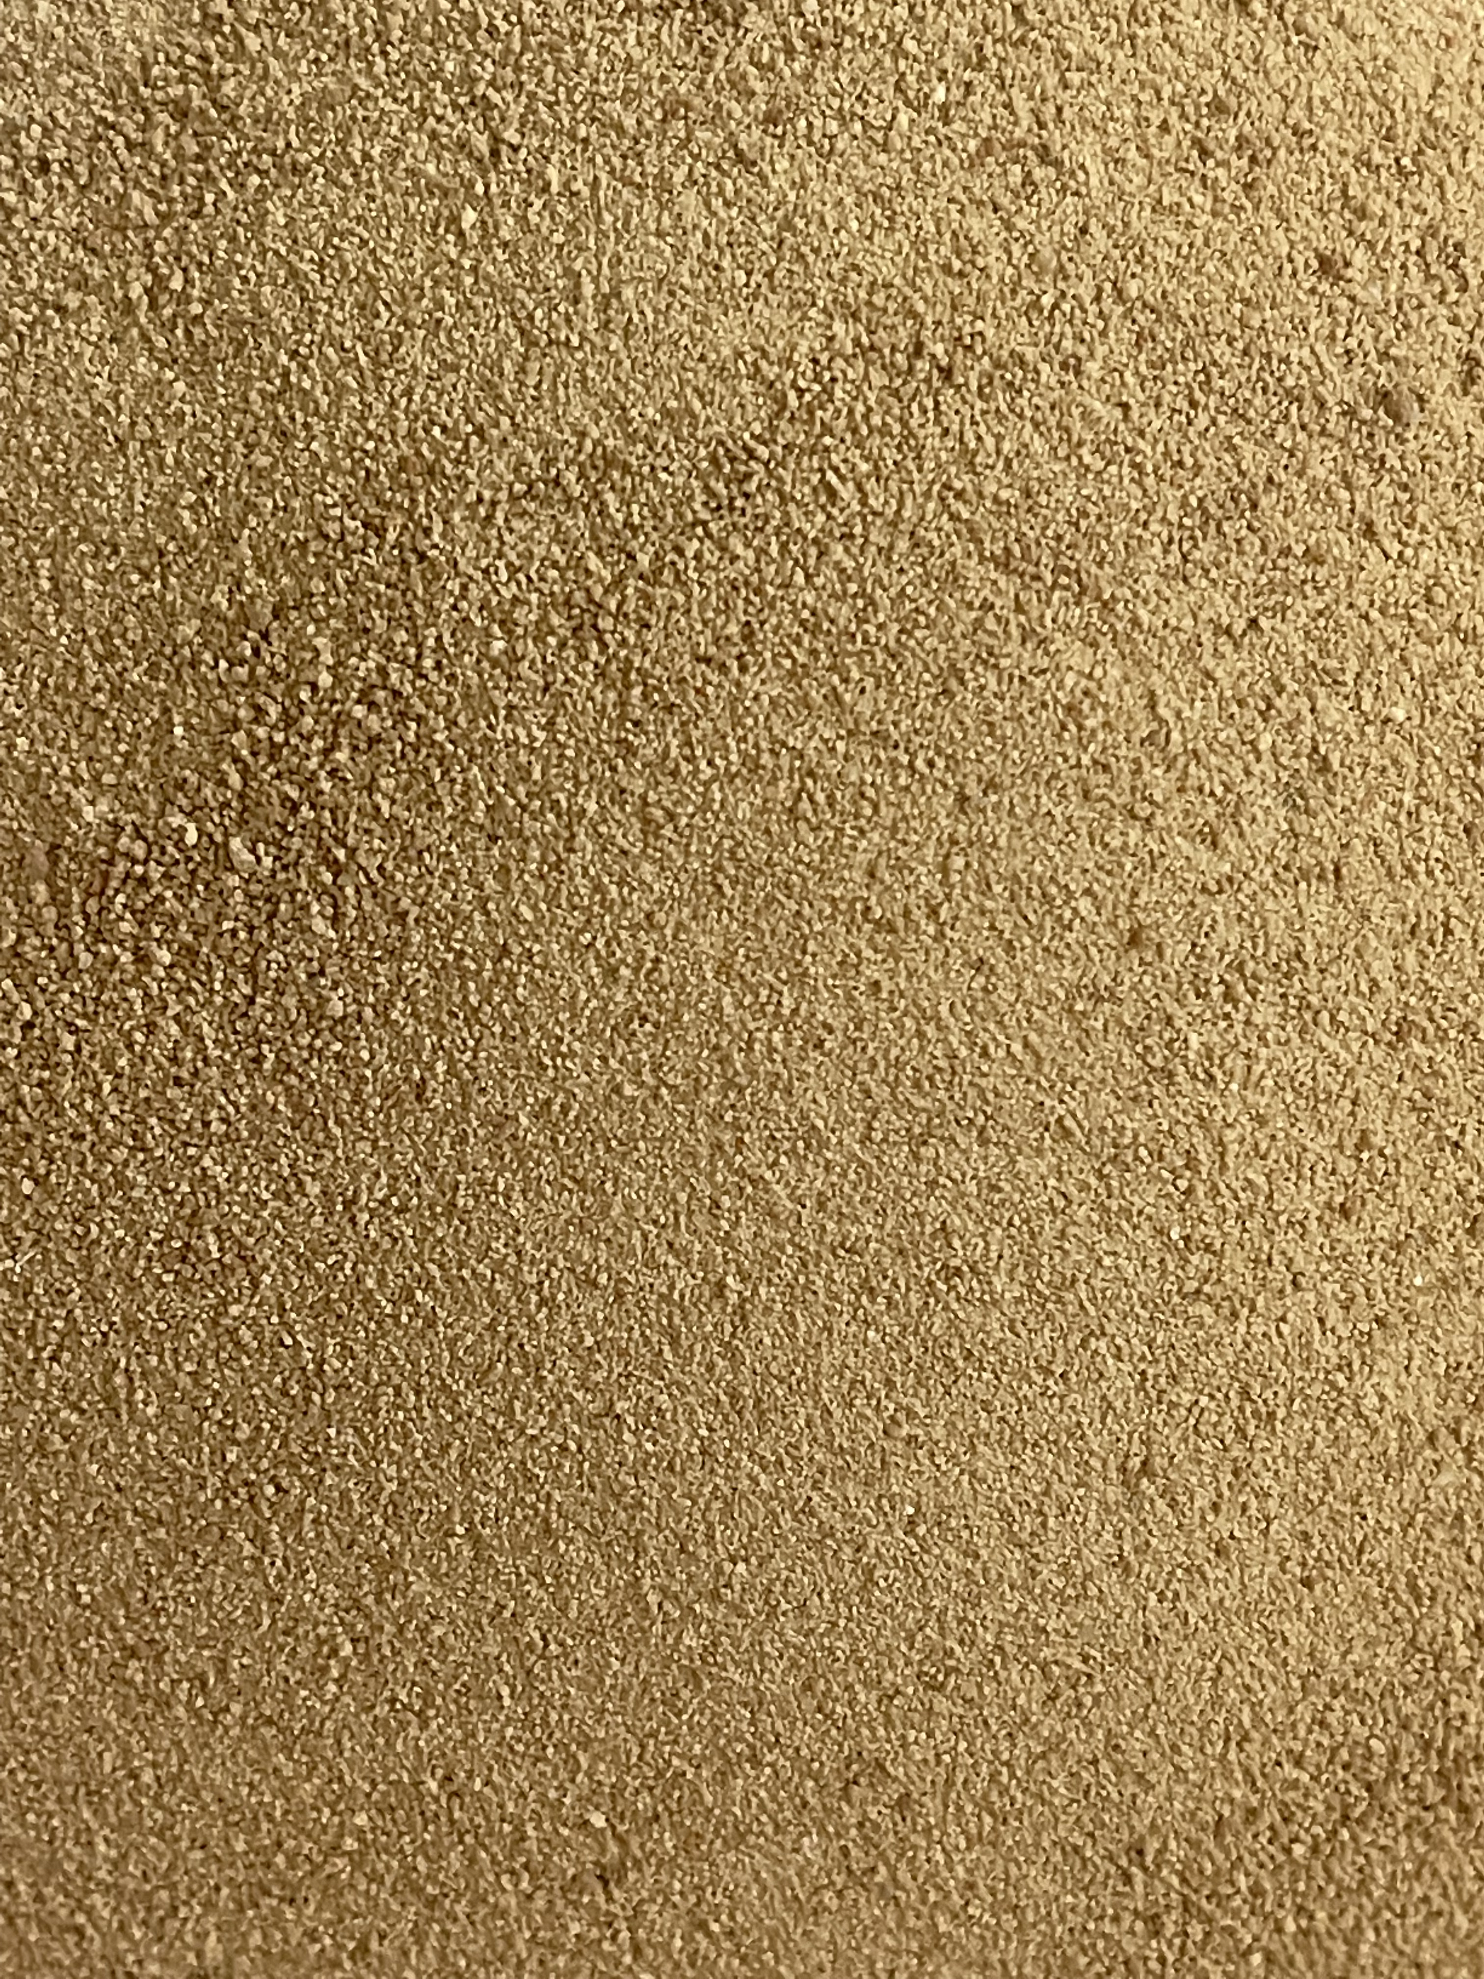
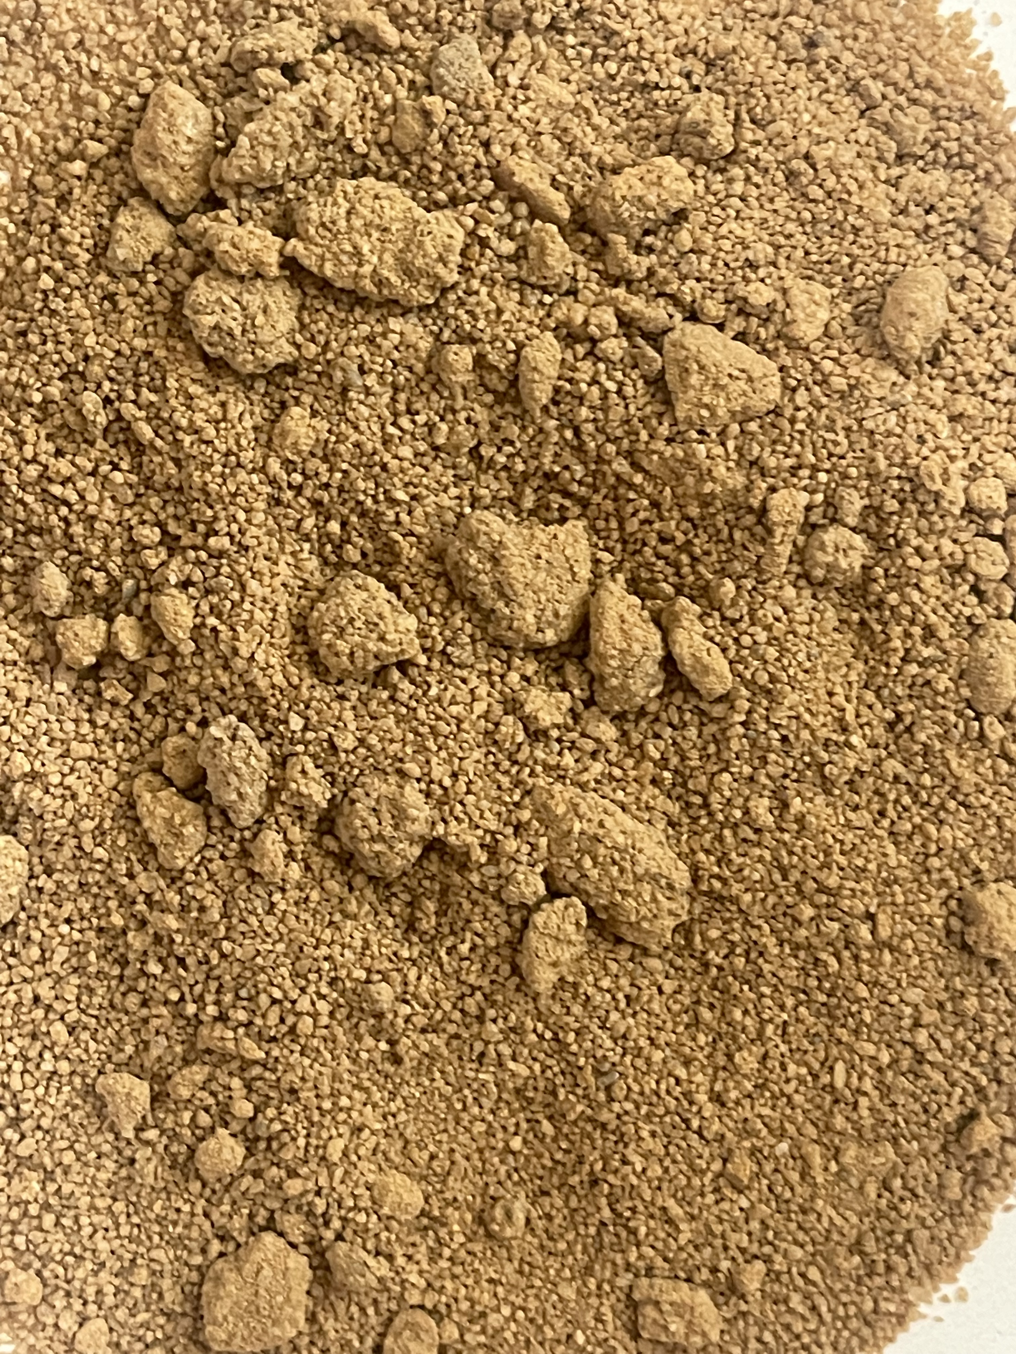
LANDSCAPE AND DECTORATIVE ROCK, STONE & SAND

Slide 11
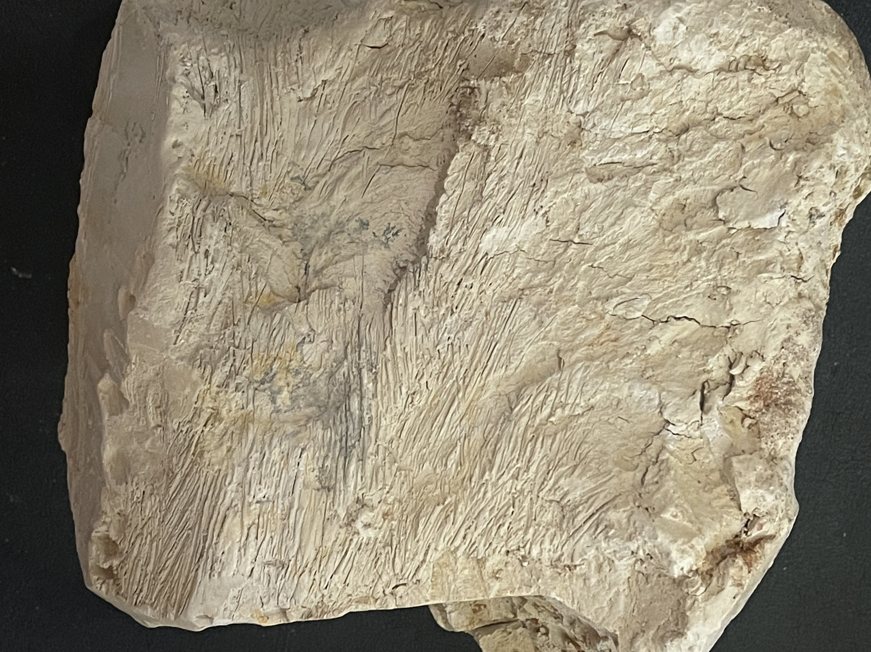
BALL CLAY
In addition to the millions of tons of aggregate reserves BC owns, possibly the largest ball clay deposit in North America sits beneath BC’s aggregates. The proven deposit information is based upon extensive drilling to determine the deposit geographical size and depth.

Slide 12
GEOLOGICAL REPORT
Sampling, testing and analysis by one of the most experienced professional clay geologists in America, Larry Kirk.
Mr. Kirk’s Resume
Larry G. Kirk Phone: 270 928 2526 (H)
1421 Paradise Rd. 270 210 9372 (C)
Tiline, KY 42083 Email: lgkirk@hotmail.com
EDUCATION
1974 BS Geology – Murray State University
1974-2000 Continuing Education in areas including Remote Sensing Applications for Exploration, Legal Workshops for Minerals Development, ISO Auditor Training, MSHA Instructor Training, Mine Permitting and Environmental Compliance

Slide 13
PROFESSIONAL ASSOCIATIONS
Registered Professional Geologist – Kentucky #112113
Society of Mining Engineers
Clay Minerals Society
MSHA Qualified Instructor
EXPERIENCE
2014 – Present Consulting Geologist – Industrial Minerals. Exploration, Greenfield
Projects, Reserve Analysis, and Permit Compliance in areas including
Ceramic Clays, Kaolins, Limestone, Sand & Gravel, and Fluorspar.
2000-2014 Geologist – Old Hickory Clay Company. Primary responsibilities include
exploration and acquisition of ball clay and kaolin reserves in KY, TN,
GA, and MS., establishing a mine quality control program, and various
permitting and mine engineering duties.
2000-2014 Geologist – Mid-South Construction Company (aggregates subsidiary of
Old Hickory Clay Company). Primary duties include exploration for
limestone and sand and gravel resources. Greenfield permitting, mine
planning, and reserve analysis of high-calcium limestone project.

Slide 14
1983-2000 Chief Geologist – Kentucky-Tennessee Clay Company. Exploration and
reserves acquisition for ball clays, kaolins, and feldspar in the
Southeastern, South-Central US, and Mexico. Directed mine planning
and quality control for all production areas, and reclamation activities
in KY, TN, and MS. Corporate Manager for ISO certification in MS and SC.
1981-1983 Geologist – Kentucky-Tennessee Clay Company. Supervised surveying,
mapping, and drilling for clay mines in KY, TN, and MS.
1979-1981 Project Geologist – Marathon Oil Company. Supervised field exploration
programs for base metals in the mid-continent and southeastern US.
1974-1979 Mine/Exploration Geologist – Frontier Spar Corporation. Supervised
exploration programs for fluorspar and base metals in KY-IL. Supervised
underground mapping and ore control at two sites in KY.
------END of Resume------
Mr. Kirk identifies a myriad of potential beneficial uses for the ball clay. This material is suitable for ceramics, compliance clay for ash disposal, superior quality oil and gas fracking agents, and Portland cement production.

Slide 15
Characterization of these reserves
BALLARD CONSERVATION, LLC
Typical Data Sheet – Clay
LOCATION
A large clay deposit has been delineated in far western Kentucky approximately 6 miles east of Wickliffe, KY near the town of Blandville, KY. From Wickliffe, the deposit can be accessed via county and state roads. Wickliffe is located on the confluence of the Ohio and Mississippi Rivers and has port and rail facilities.
DEPOSIT
The material is a kaolinitic ball clay generally similar in age and composition to the clays found in the Kentucky-Tennessee Ball Clay District twenty miles to the southeast. The clay is very plastic and is generally light brownish gray to olive gray with some reddish- brown iron-stained intervals near the top of the clay sequence. The clay is siliceous with most of the silica ranging from finer than 325 mesh to colloidal size particles. An interval of carbonaceous strata with some interspersed lignite lenses occurs near the middle of the clay sequence. This interval will not be mined during the clay production.

Slide 16
TYPICAL CHEMICAL/PHYSICAL RESULTS
Test Range Deposit Average
Al2O3 16.0-23.9% 20.6% SiO2 62.7-75.5% 66.9% Fe2O3 1.63-3.64% 2.42% TiO2 1.34-1.56% 1.37% MgO 0.50-0.86% 0.69% CaO 0.30-0.57% 0.32% K2O 0.89-1.55% 0.97% LOI 5.16-8.02% 6.65% 325 Mesh Residue Generally 1.0-10.0% Less than 4.0% In Ground Moisture 18% Average
------END of Characterization------

Slide 17
BALLARD CONSERVATION, LLC
Blandville, KY Property
SUMMARY OF WORK AND RESERVE POTENTIAL
BALL CLAY & SAND/GRAVEL
(1) SETTING/HISTORY/CURRENT STATUS
Ballard Conservations’ 350- acre property is located in extreme western Kentucky in southern Ballard County. Roughly 1.25 miles west of Blandville, the property is accessed by Bethlehem Church Road which bisects the property, and Hershel Jones Road which serves as the northern boundary of the property. It is primarily an upland area bordered by Stovall Creek to the west. An unnamed tributary to this creek traverses the southern third of the property in an east-west direction. The property is approximately 6 road miles from Wickliffe, KY where port facilities are available at the confluence of the Mississippi and Ohio Rivers.
The current owners initially permitted a pre-law sand and gravel pit existing on the property in 2011. Sand and gravel was intermittently mined from this area on a small scale for the next 5 years. In 2015, a ball clay lens was discovered below the sand/gravel formation. This clay was subsequently tested through core drilling over roughly half of the property. The initial work conducted by Ballard Conservation (BC), consisted of six drill holes in April, 2015. Following this work, BC completed an additional four holes in November, 2016. Finally, a third party completed an additional six holes in April/May, 2017. Testing was completed on all of the drill cores including 8- oxide chemistry, residue, and strength for the clay intervals.

Slide 18
Currently, a new surface mining permit has been issued for on the property which includes a Corps of Engineers review of regulated streams. Additionally, a haul route from the property to a port facility in Wickliffe has been approved and only awaits bonding.
(2) GEOLOGY
SAND & GRAVEL
The property is underlain by two formations of Pleistocene alluvial gravel, The uppermost of these occur generally from elevations of 400 to 450 ft. This is the formation from which mining has occurred and the formation from which reserve estimates for the property have been given. It consists primarily of reddish brown sub-angular to rounded chert, quartz, and quartzite pebbles in a matrix of reddish brown to dark yellowish brown sand. Most of the gravel is less than 2 inches in the longest dimension although some are as long as 6 inches. The sand is fine to coarse and may occur as distinct interbeds within the gravels in addition to a matrix material. The sand/gravel formation is up to 40 ft. in thickness. Gradation testing of this material is currently being conducted by the State of KY.

Slide 19
CLAY
This property is located at the northern end of the Ball Clay District which forms an arcuate belt through western KY and western TN, into northwest MS. The nearest currently active ball clay mine is roughly 25 miles southeast of the BCC property. Currently there are approximately 40 active ball clay mines in these three states serving primarily ceramics-related and filler markets worldwide. Ball clays are kaolinitic sedimentary clays with varying amounts of other clay minerals including primarily iolite and smectite. Alumina/silica ratios vary from true kaolin clays in that they are more siliceous. They also have varying amounts of carbon and are much finer-grained. These properties give them higher strength and plasticity than kaolin.
Most ball clay deposits in the tri-state area range from 100,000 tons to a few million tons. They mostly appear to be erosional remnants of what was at one time much more widespread deposits. The BC deposit is unique in it’s size which is indicated to be in excess of 20 million tons, possibly in the 30 million-ton range. The deposit ranges in thickness from 23 to 60 ft. and is 150 acres + in lateral extent. Of the 16 holes drilled on the property, only one on the north end of the tract failed to find clay. The deposit itself is olive gray to light olive gray and locally contains a carbonaceous, lignite section near the middle of the clay section. It is a very clean (low residue) clay and overall has alumina values in the 20% range. The top of the clay section is higher alumina with one cored section of 8.0 ft. of 27.4% Al. Fe values are in the 1.5% range but increase at depth in some areas to the 3% range. The deposit is essentially flat-lying but does dip to the SSW on the southern section of the deposit. Overburden consisting of unconsolidated sands, gravels, silts, and waste clays range from 7 ft. near the outcrop area to 68 ft. with an overall average in the 30 ft. range. In areas above the 420 ft. elevation however, any production of sand and gravel would significantly diminish the thickness of waste overburden.

Slide 20
(3) RESERVES
SAND & GRAVEL
The uppermost sand and gravel deposit occurs across the entire property and its’ lateral extent is controlled only by surface elevations. The formation occurs from roughly a 400 – 450 ft. elevation. For reserve calculations, only areas with elevations of 420 ft. or higher were used along with an average thickness of 30 ft. A density factor of 1.7 tons/cubic yard was used. Reserves were calculated separately for areas north and south of the east-west creek located on the southern 2/3 of the property. A 5% loss was used to account for property line setoffs.
Sand & Gravel Reserves (North of Creek) = 9.3 million tons – 118.9 Acres
(South of Creek) = 2.7 million tons – 34.3 Acres
Total Sand & Gravel Reserves = 12.0 million tons
BALL CLAY
For clay reserve calculations, a 35 ft. average thickness was used which would account for any inter-burden and normal mine loss. For property line and road setoffs, an additional 20% loss was calculated for reserves north of the creek, and 15% loss for reserves south of the creek. No reserves were calculated for areas below the 360 ft. elevation. Reserves north of the creek are given as “Drill Inferred” while reserves south of the creek are given as “Possible”. A density factor of 135 lbs./cubic ft. was used. Tons are given as short wet tons.

Slide 21
Ball Clay Reserves (North of Creek) – Drill Inferred = 22.3 million tons
270.8 Acres
(South of Creek) – Possible Reserves = 10.2 million tons
133.4 Acres
(4) Discussion of Property Potential
Two factors are of upmost importance in discussing the potential for this property, the proximity to river transport, and the size of the deposits. Gradation test results currently being conducted will provide information as to the market potential of the sand and gravel although testing by a third party has already indicated the sand meets asphalt requirements. Physical and chemical testing of the clays conducted to date certainly indicate that this material could potentially serve ceramic markets, cement markets, and other filler applications. Two of the three companies currently in the ball clay business market clays to consumers via river transport and both have hauls in excess of 40 miles to port facilities from their operating mines. The size of the deposit also would allow long-term production for high-tonnage consumers such as cement manufacturers. The cost of many industrial minerals to the final consumer includes transportation costs that are equal to, or in excess of the cost of the material on site. The BC site could potentially deliver clays or sand/gravel products to consumers via river transport at significantly lower costs.
L.G. Kirk, PG
December 1, 2017

Slide 22
DISPOSAL SITE CAPABILITIES FOR ASH AND OTHER POWER PLANT BYPRODUCTS
The removal over time of the mineral located at the BC 350 acre site will create considerable air void for waste material and ash disposal. Just on the current permitted site of 100 acres the depth of void will average 100 feet, thus creating 12 million cubic yards of airspace. The creation of a new port and the construction of a dedicated conveyor (port to mine & mine to port) will allow power plant to disposal site transportation with no over the road trucking. Additionally a ball clay deposit is one of the most hydraulically isolated formations in Nature with extremely high soil permeabilities.

Slide 23
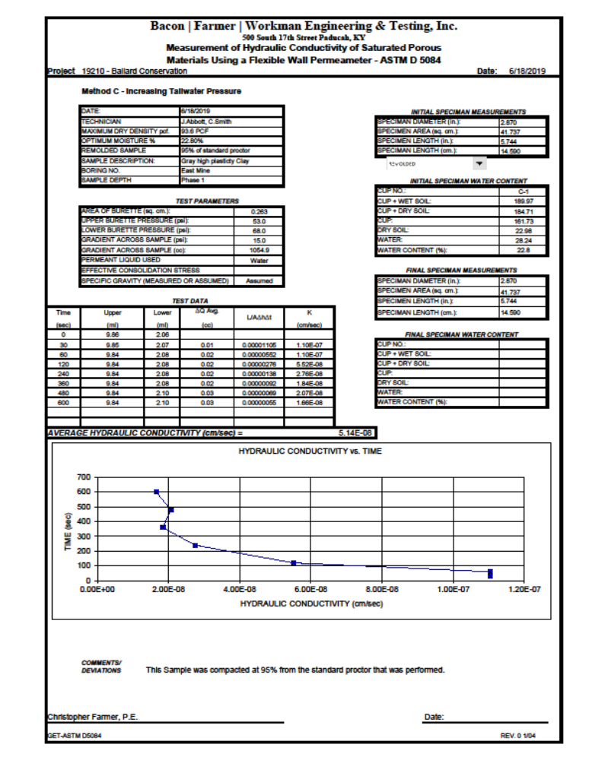
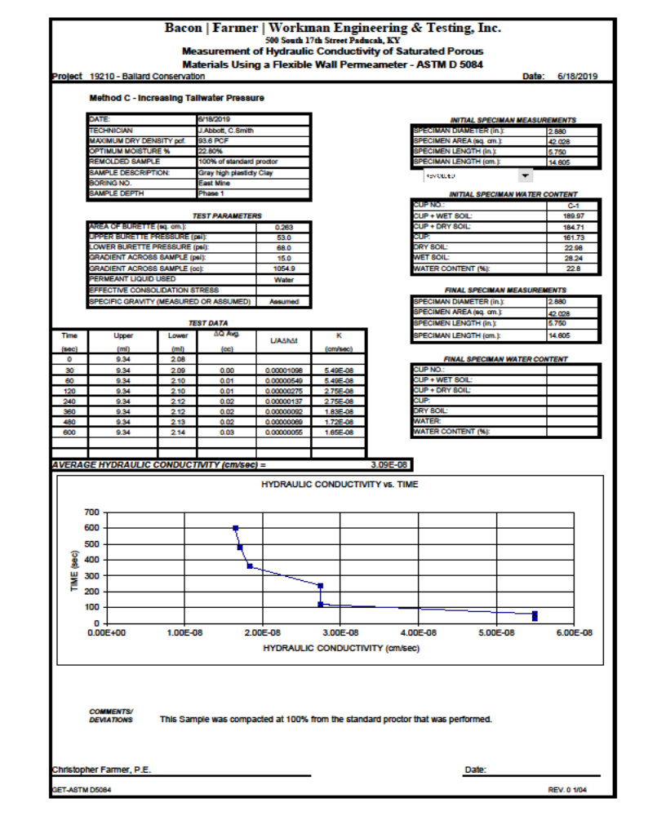
Clay
Permeability Test Results

Slide 24
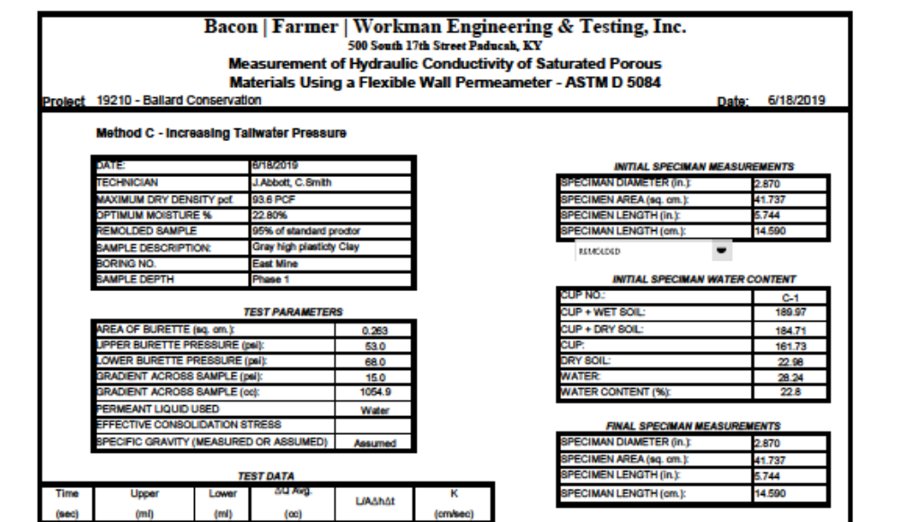
Clay Permeability Test Results 95% Proctor (Page Top)

Slide 25
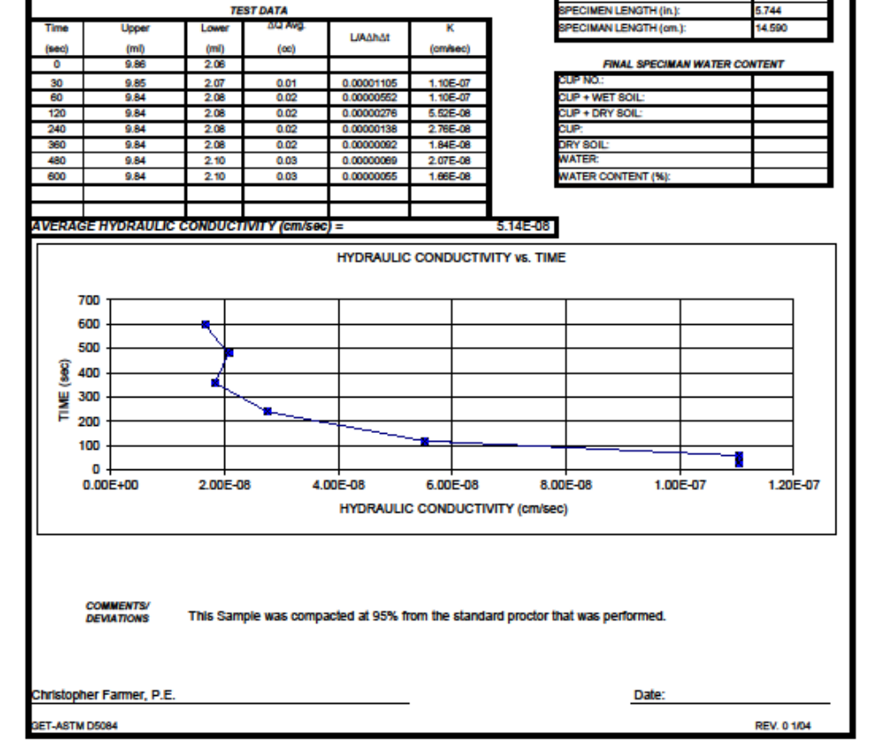
Clay Permeability Test Results 95% Proctor (Page Bottom)

Slide 26
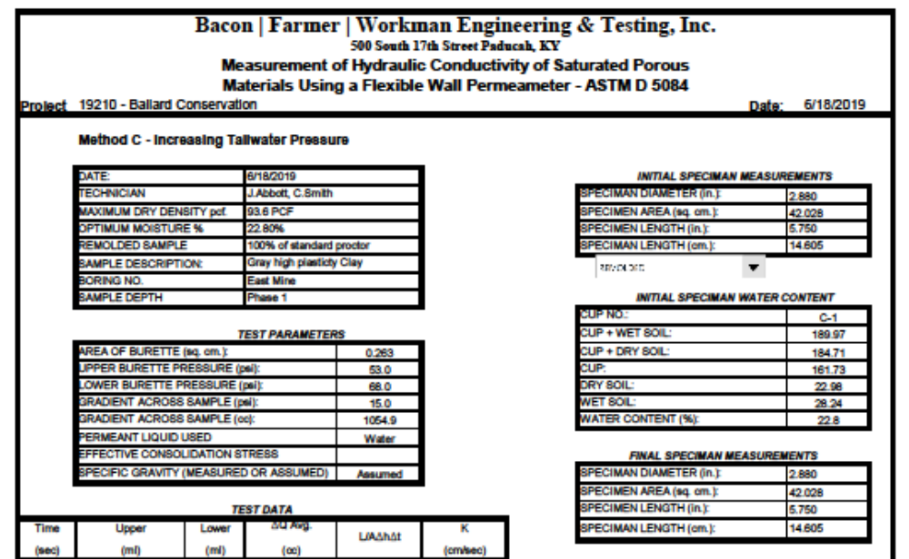
Clay Permeability Test Results 100% Proctor (Page Top)

Slide 27
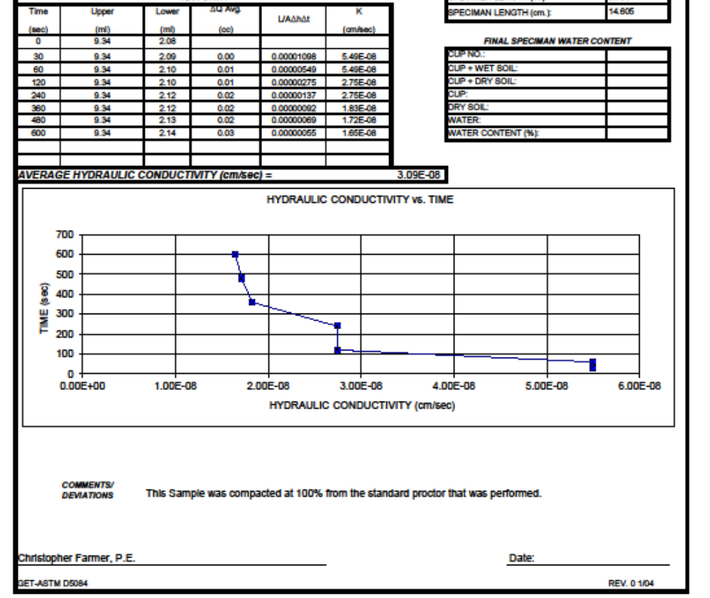
Clay Permeability Test Results 100% Proctor (Page Bottom)

Slide 28
SUMMARY
BC has extensive mineral assets of 12 million tons of rock-sand and 30 million tons of ball clay. This capacity puts BC in the unique position to strengthen any investors balance sheet and market cap immediately. Through successful marketing, and build out of production capacity (higher valued products such as bricks), BC minerals have a very high ceiling. Most importantly the operational 100 acre quarry has all the necessary components; required permits local, state and national (due to be renewed in 2023). BC will expand operational equipment to extract and process the mineral, transportation facility’s for marine and rail, and site preparation for increased mineral extraction. Ballard Conservation, LLC is looking for an investor that will share this vision to commercialize its mineral assets to it’s maximum extent possible. More complete and verifiable documentation will be provide with appropriate protection agreements in place.

Slide 29
Thank You!
Ballard Conservation, LLC

